Slide 1
Segment Trees
Range queries

Slide 2
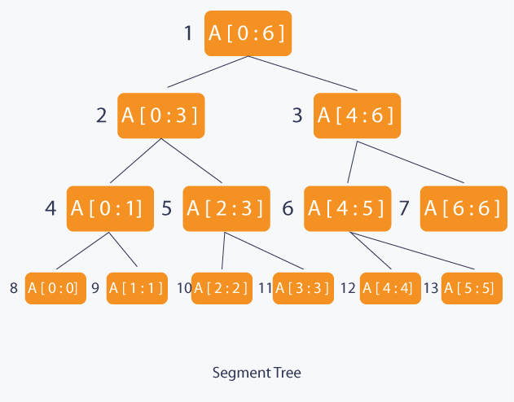
Basics
A segment tree is a way of querying ranges in log(n) time
More powerful than prefix-sum arrays
Divides the range into halves constantly until the size of ranges is length of 1
Creates a binary tree

Slide 3
Complexity
Time Complexity: O(logn) per query
Space Complexity: nlogn

Slide 4
Creating Segment Trees
Two ways:
Bottom to top
Top to bottom to top

Slide 5
Querying Segment Trees
Say we are querying the range [L, R]
We start at the root of the segment tree at Seg[i], where i = 1
If Seg[i] is the exact same interval as [L, R], then return the answer at Seg[i]
Otherwise, find the middle of the interval that Seg[i] covers
If the R <= middle, then continue to query on the left child of Seg[i]
Else if the L > middle, then continue to query on the right child of Seg[i]
If you reach this point, return the max/gcd/min of the both the left and right child queries

Slide 6
Segment Tree Use Cases
Not all ranges can be queried using segment trees
Range of values of segment trees must be able to be combined to create a value for the larger range
E.g. GCD, Min value, max value
Let’s say we have an array p = [6, 12, 24, 4, 10, 6]
GCD(p[0:3]) = 6
GCD(p[3:6]) = 2
GCD(p[0:6]) = GCD(GCD(p[0:3]), GCD(p[3:6])) = 2

Slide 7
Problem
Try implementing a segment tree for now
https://dmoj.ca/problem/ds3

